Slide 1
Testing Session-8

Slide 2
Agenda
Agile Model
Agile development methodology
Scrum Methodology
Scrum Methodology Working Progress
Agile-Scrum frame work

Slide 3
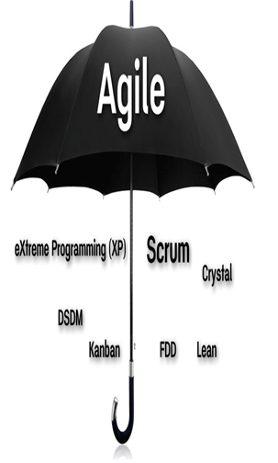
Agile Model
Extreme Programming(XP)
Dynamic System Development Method
Kanban
Scrum
Crystal
FDD(Feature Driven Development)
Lean

Slide 4
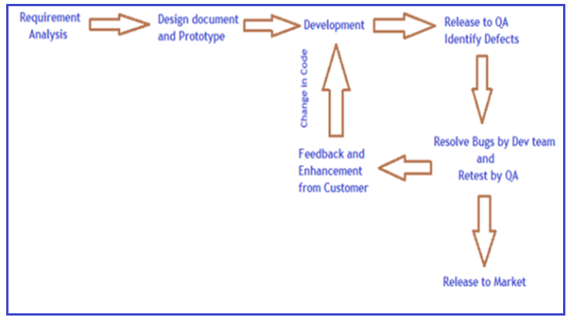
Agile development methodology

Slide 5
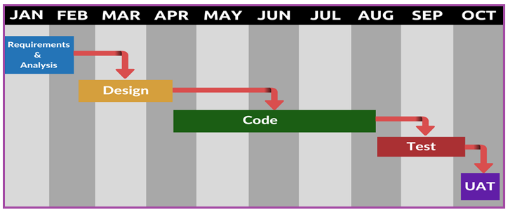
Traditional software development

Slide 6
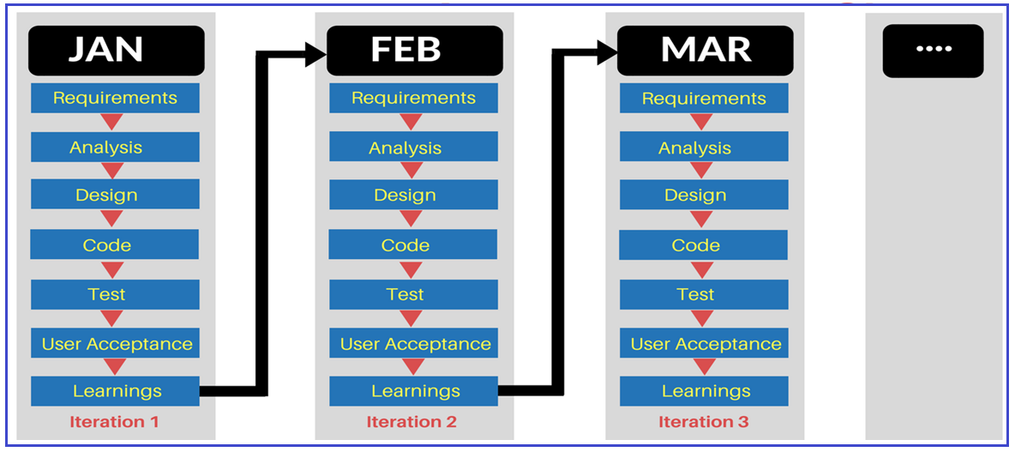
Agile development methodology

Slide 7
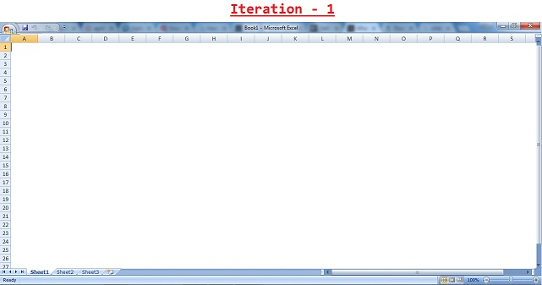
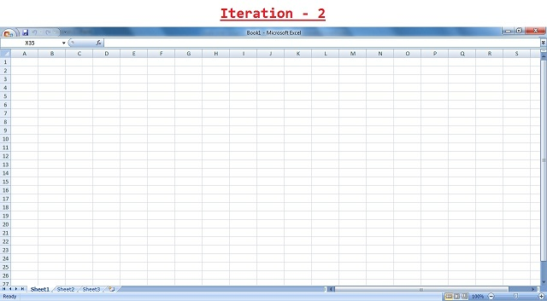
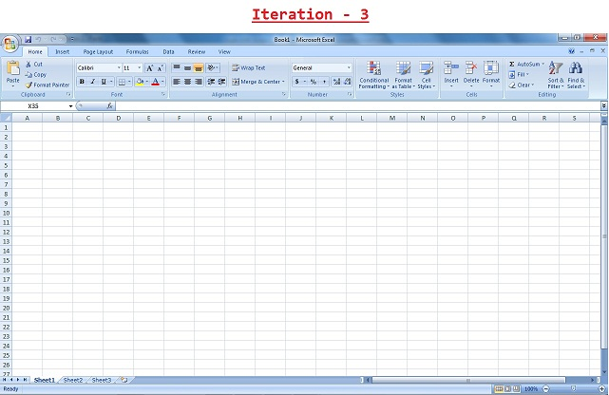
An example of how software may evolve through iterations

Slide 8
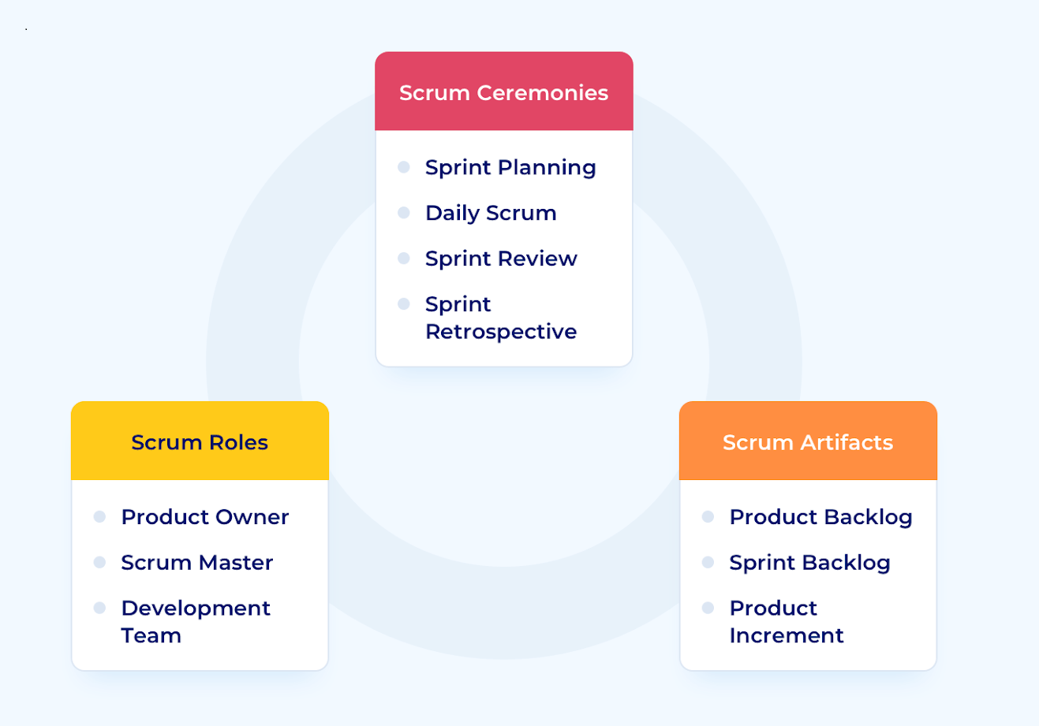
Scrum Methodology

Slide 9
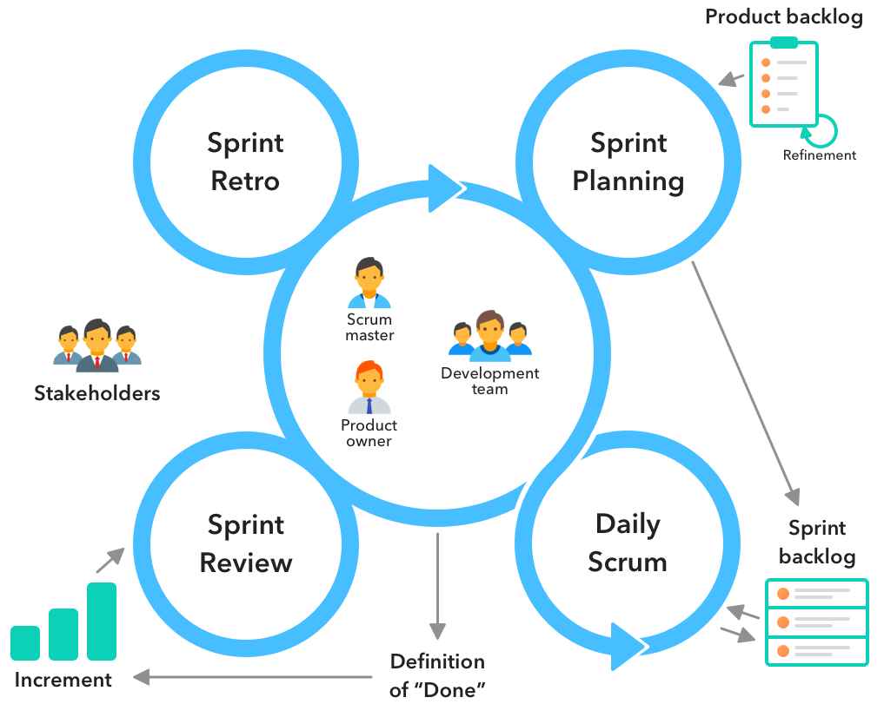
Scrum Methodology Working Progress

Slide 10
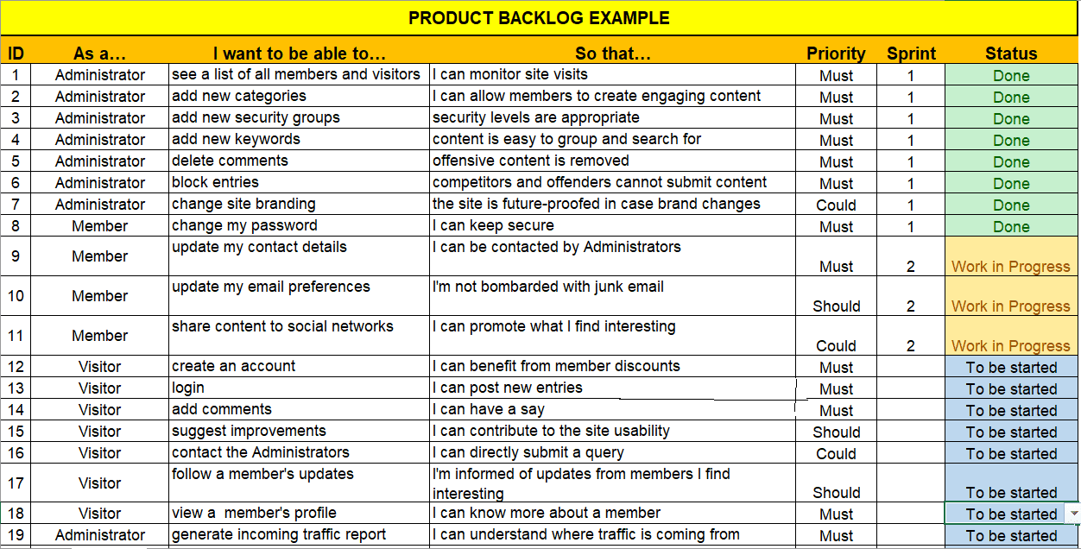

Slide 11

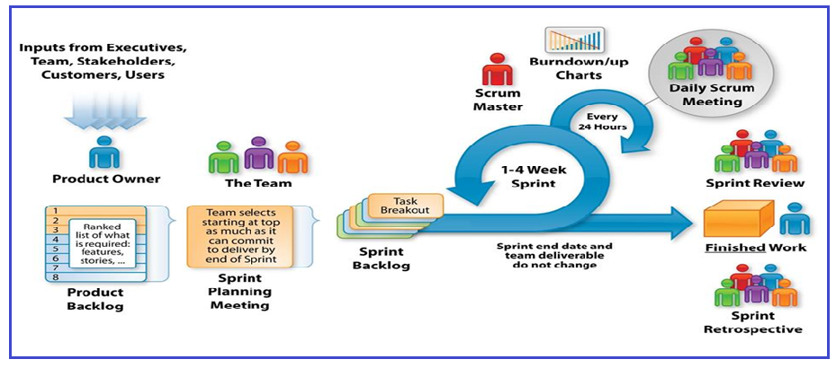
Agile-Scrum frame work

Slide 12
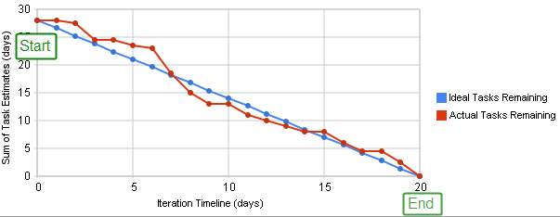
Scrum Burn Down Chart

Slide 13
Why Swhizz?
Following the project-oriented training By working on user stories
Real time people will deliver the classes
Hands on experience.
One to One monitoring
Interaction sessions
Doubts Clarification Session
Expertise in resume preparation
Mock interviews
Job assistance
Associated with 50+ Clients
900+ students got placed

Slide 14
Any Queries?

Slide 15
Thank You
Mr.SubbaRao (Relationship Manager)
Contact:9059002244

